Slide 1
Name : Youssef Tarek
Id : 2301606
Name : Asaf Adel
Id : 2301635
Name :Youssef Hassan
Id : 2301633
Name : Hamdy Mohammed
Id : 2301590
Name : احمد علي عبد العال احمد
Id : 2302553
Name :Abdallh Omran Fareed
Id : 2301680

Slide 2

Project Description This project predicts car prices using a dataset from AutoScout24 Germany, sourced from Kaggle. It involves data cleaning, exploratory data analysis (EDA) with visualizations, and building a RandomForestRegressor model to achieve accurate price predictions. The results are presented in a structured report.

Slide 3
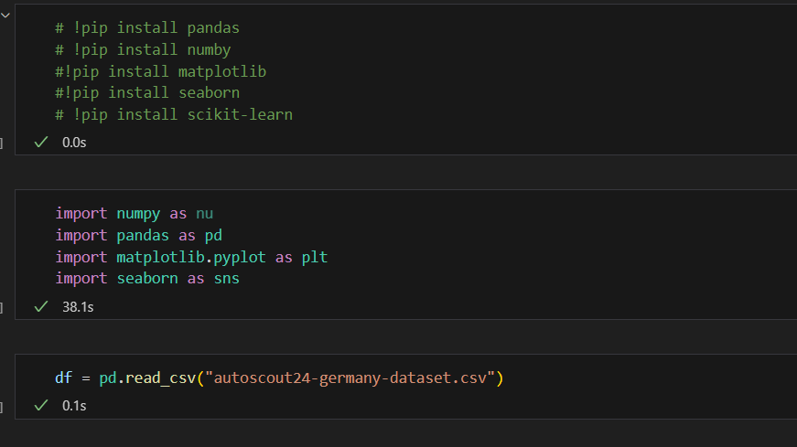
Initial Setup and Data Loading This slide shows the initial steps of the project: installing required libraries (pandas, numpy, matplotlib, seaborn, scikit-learn) using pip, importing them with aliases (e.g., numpy as nu, pandas as pd), and loading the AutoScout24 Germany dataset from a CSV file into a pandas DataFrame for analysis.

Slide 4
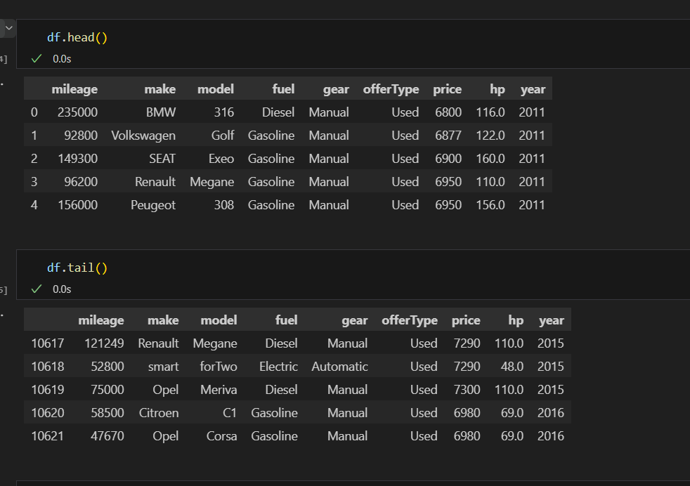
Dataset Overview This slide displays the first and last five rows of the dataset using df.head() and df.tail(). It includes columns like mileage, make, model, fuel, gear, offerType, price, hp, and year, showing cars from 2011 (e.g., BMW 316, €6800) to 2016 (e.g., Opel Corsa, €6980), highlighting the dataset's diversity.

Slide 5
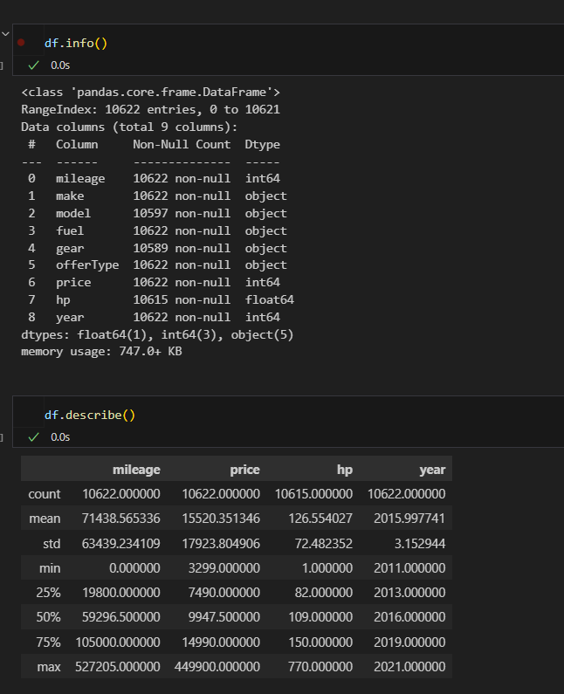
This slide presents the dataset's structure using df.info(), showing 10,622 entries with 9 columns, some with missing values (e.g., 25 in model). df.describe() provides statistics for numerical columns, revealing a mean price of €15,520, average mileage of 71,438 km, and cars ranging from 2011 to 2021.

Slide 6
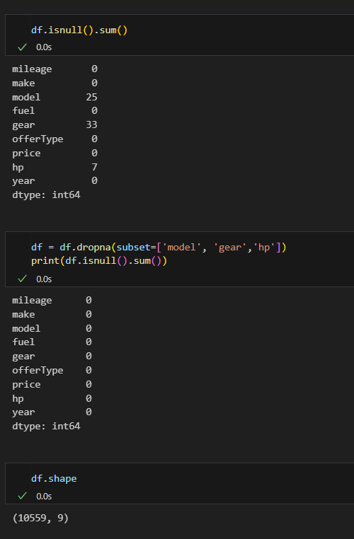
This slide shows the data cleaning process: df.isnull().sum() identifies missing values (25 in model, 33 in gear, 7 in hp). df.dropna() removes rows with missing values in these columns, resulting in zero missing values. df.shape confirms the cleaned dataset size as 10,559 rows and 9 columns.

Slide 7
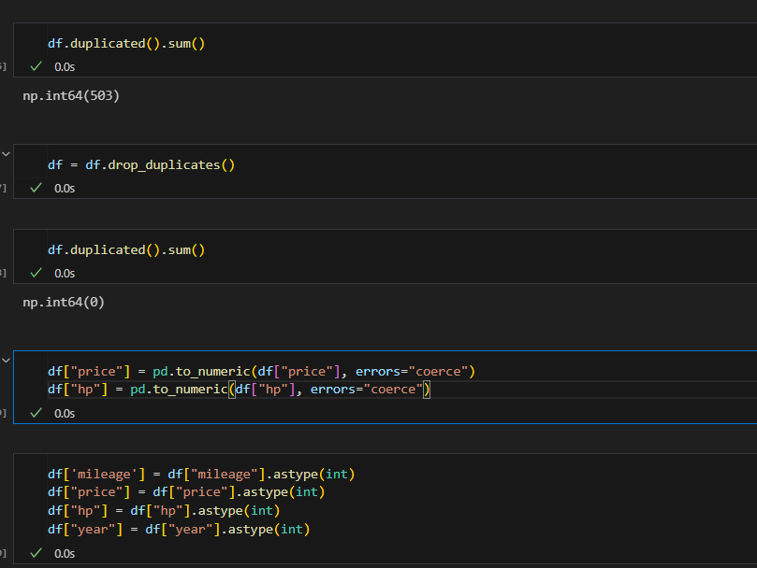
This slide details additional cleaning steps: df.duplicated().sum() identifies 503 duplicates, which are removed using df.drop_duplicates(), leaving zero duplicates. Numerical columns (price, hp) are converted using pd.to_numeric() with error handling, filled with mean values if needed, and all relevant columns (mileage, price, hp, year) are cast to integer type using astype(int).

Slide 8
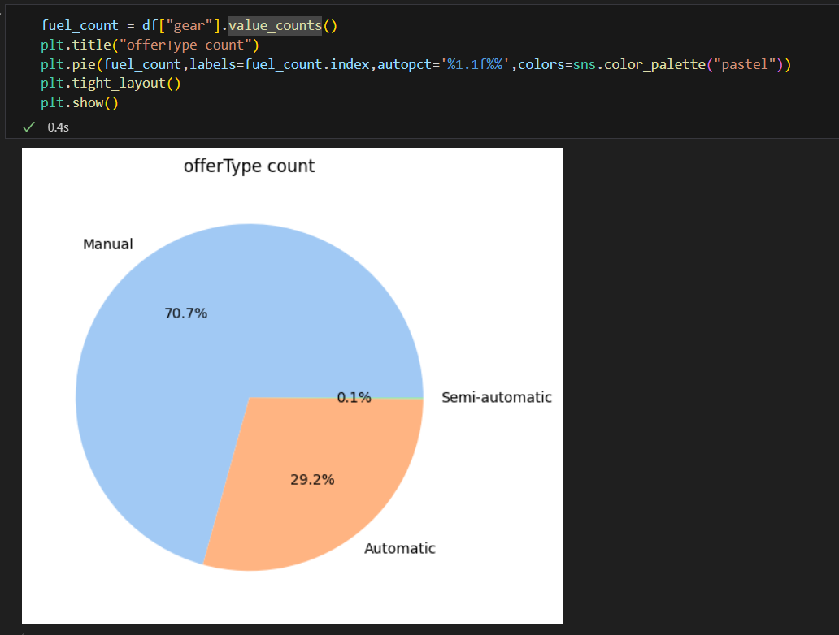
This image displays a pie chart illustrating the distribution of gear types in car offers. The percentages show that 70.7% of the cars have a Manual gear, 29.2% have an Automatic gear, and only 0.1% have a Semi-automatic gear. The chart was created using Python with the pandas and matplotlib libraries.

Slide 9
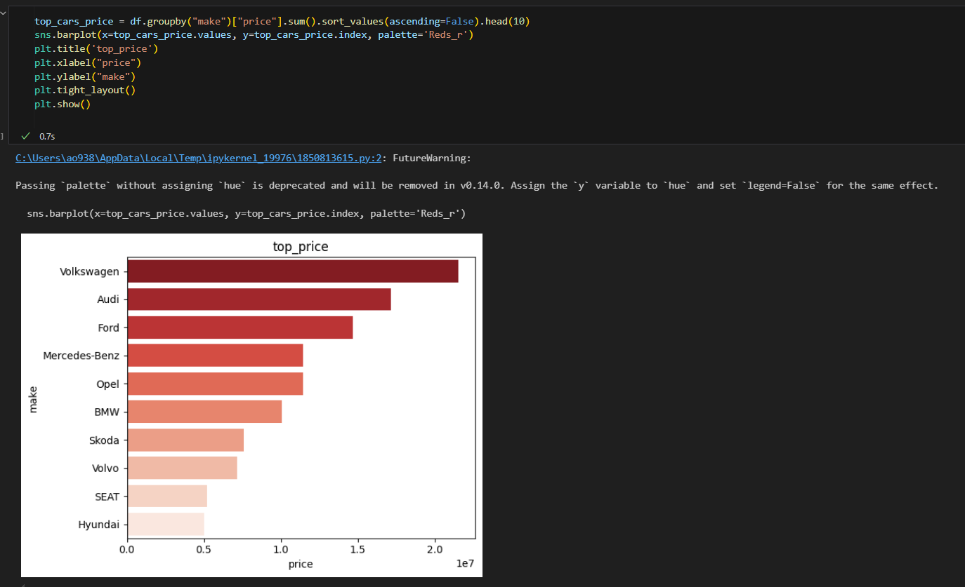
EDA: Top Price by Make This slide displays a horizontal bar plot showing the top 10 car makes by total price, using seaborn and matplotlib. Volkswagen leads with the highest total price (around 2e7), followed by Audi, Ford, and Mercedes-Benz, while Hyundai and SEAT have the lowest among the top 10. The plot uses a red color palette.

Slide 10
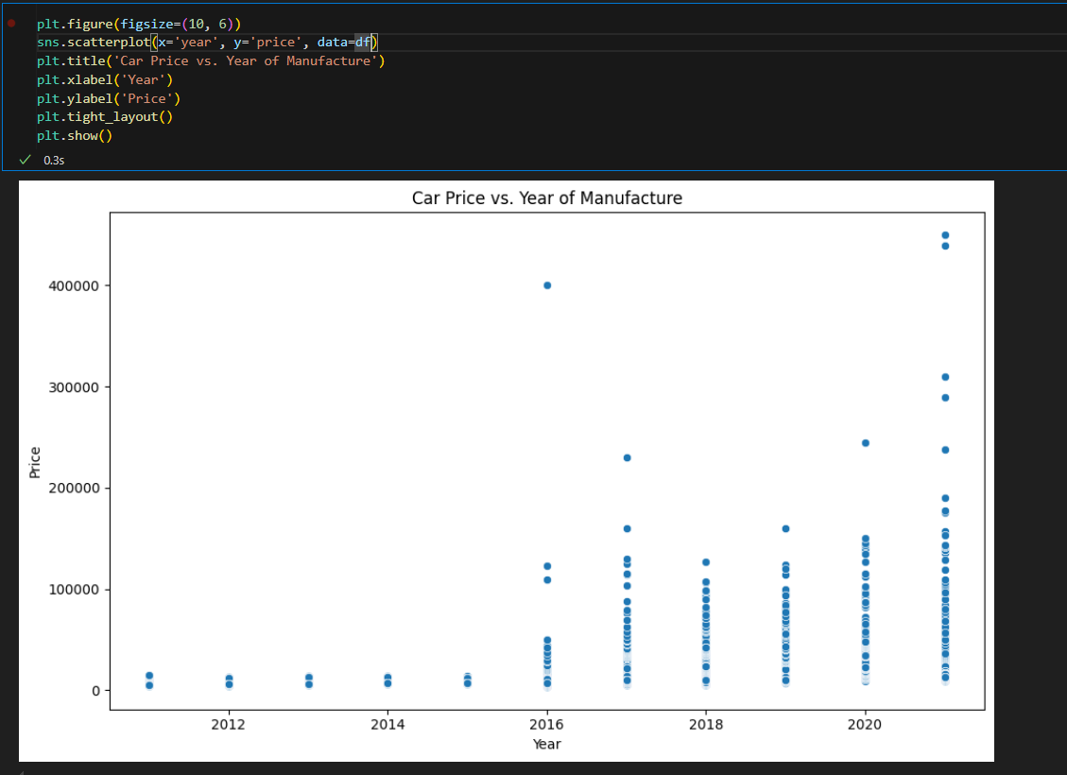
EDA: Price vs. Year of Manufacture This slide presents a scatter plot of car prices against their manufacturing year, created using seaborn and matplotlib. It shows a trend where newer cars (2018-2021) generally have higher prices, with most prices clustering below €100,000, and a few outliers reaching up to €400,000, particularly for newer models.

Slide 11
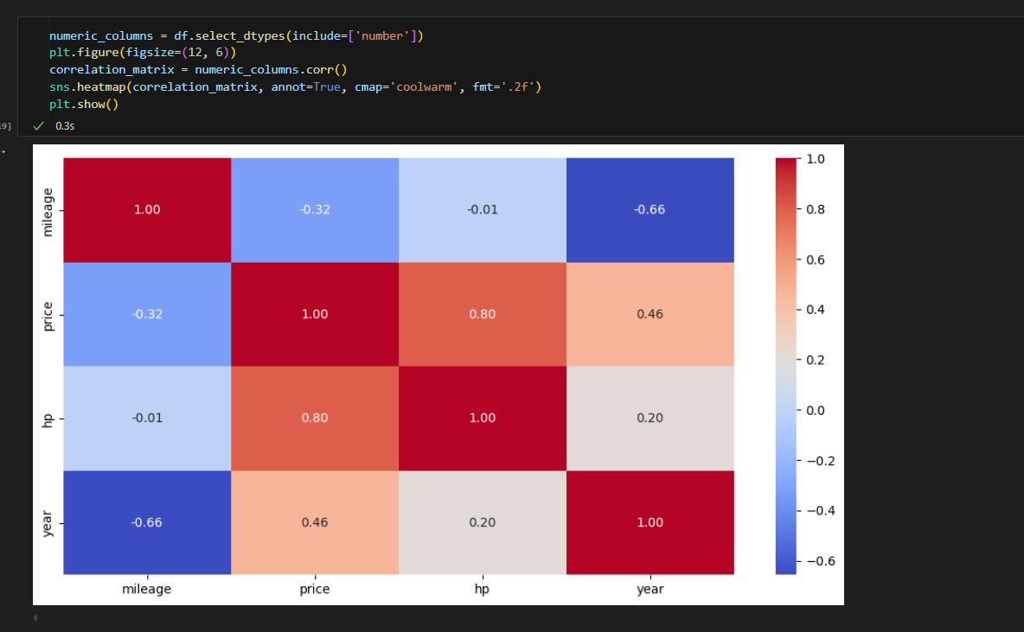
EDA: Correlation Heatmap This slide shows a correlation heatmap for numerical columns (mileage, price, hp, year), created using seaborn and matplotlib. Key correlations include price with hp (0.80) and year (0.46), indicating strong positive relationships, while mileage has a negative correlation with year (-0.66), suggesting newer cars have lower mileage. The heatmap uses a coolwarm color scheme.

Slide 12
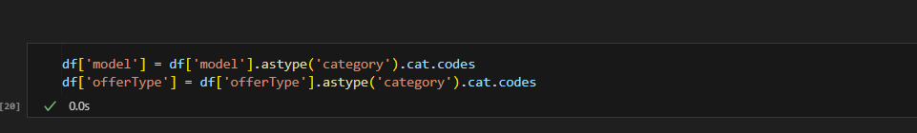
Data Preprocessing: Encoding Categorical Variables This slide shows the conversion of categorical columns "model" and "offerType" into numerical codes using astype('category').cat.codes, enabling these features to be used in the RandomForestRegressor model for price prediction.

Slide 13
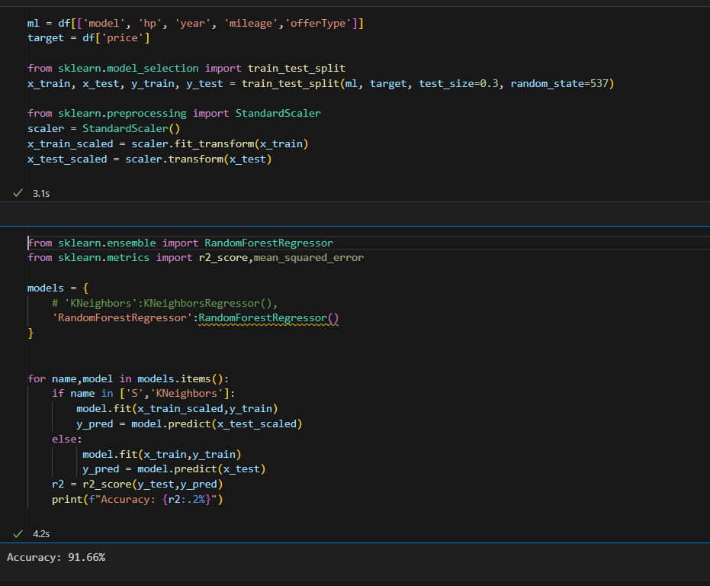
Modeling and Evaluation This slide details the modeling process: features (model, hp, year, mileage, offerType) and target (price) are selected, split into training and test sets (70-30 split), and scaled using StandardScaler. A RandomForestRegressor model is trained, achieving a 91.66% accuracy (R² score) on the test set, with comparisons to a KNeighborsRegressor model.

